Slide 1
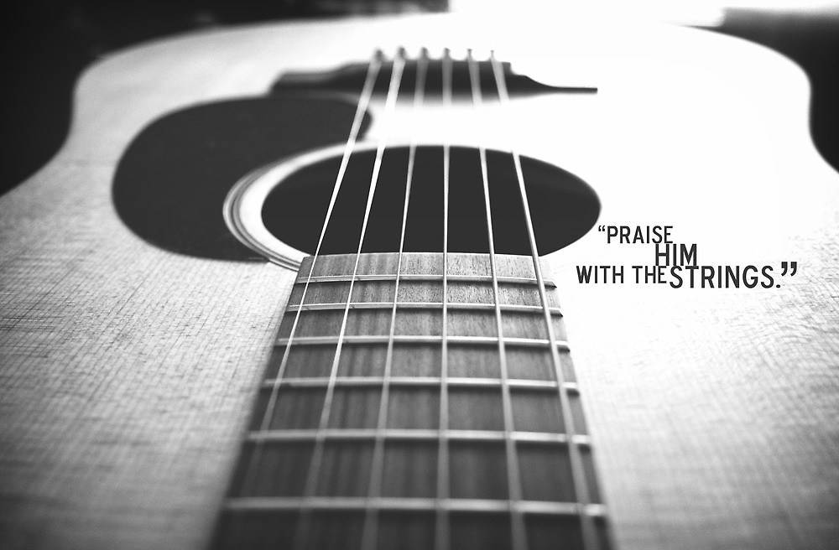

Slide 2
GUITAR 101 The BEGINNER COURSE : week 1

Slide 3
How to spot a beginner
Know the basic parts of the guitar
Identify string numbers, finger numbers and fret numbers
Know the musical alphabet
Understand how to read and draw a chord diagram
Understand the difference in sound between the three basic chord types – major, minor and dominant 7
Explain the term “root note”
Understand and explain basic time signatures, such as 4/4 and 3/4
Understand and execute basic rhythms, such as whole, half, quarter and 8th notes
Demonstrate the ability to correctly form basic open position chords and efficiently change between them: A, Am, A7, C, D, D7, E, Em, E7, G

Slide 4
Sub – group for beginner class
Instrument | Guitar |  |  |  | Bass
Mentor | Jeff | Jethro | JR | PTEarl | Grej
 | Evan | Esa | Janice | Francis | Bong
 | RJ | Rollie | PTVin | Mark | Rey

Slide 5
today’s activity : the basics
ROLES OF GUITAR PLAYERS
GUITAR PARTS
LETTER NOTATION
TUNING
FRETBOARD NOTES
BASIC STRUMMING: 4 COUNTS AND 2 COUNTS
YOUR FIRST CHORDS: C A G E D
YOUR FIRST SONG: LORD I LIFT YOUR NAME ON HIGH

Slide 6
Part 1 : basic theory

Slide 7
Letter notation
System of representing a set of pitches by letters
C – D – E – F – G – A – B
do – re – mi – fa – so – la – ti – do (diatonic scale)
Advantage : Easy to remember / memorize
Chords (combination of notes) are also represented by these letters

Slide 8
Diatonic scale
The most common scale in modern music
Scale is a set of notes played to create melodies and harmonies.
It has intervals in between, this intervals determine the difference between scales hence the difference between music melodies (western and eastern music).
Diatonic Scale (mostly used in western music)
DO – RE – MI – FA –SO – LA – TI – DO

Slide 9
Diatonic scale interval
C – D – E – F – G – A – B - C
1
note
1
note
0
note
1
note
1
note
1
note
0
note
C# or
Db
D#
or
Eb
none
F#
or
Gb
G#
or
Ab
A#
or
Bb
none
There are 12 notes from low C (base note) to high C

Slide 10
Diatonic scale – the most basic scale
Scale is a set of notes / pitches ordered from low to high
Diatonic scale is the most common scale
do – re – mi – fa – so – la – ti – do
Most songs that we play are based on this scale

Slide 12
Types and role of guitar players

Slide 13
Part 2 : guitar basics

Slide 14
Types and roles of guitar players
Rhythm (Acoustic or Electric)
provides all or part of the rhythmic pulse in conjunction with singers or other instruments.
provides all or part of the harmony, i.e. the chords.
cover up the spaces of the song
Lead (mostly electric)
plays solos (melody) or riffs (audible guitar lines)
gives special effects to the song (i.e, swells, worship ambience)

Slide 15
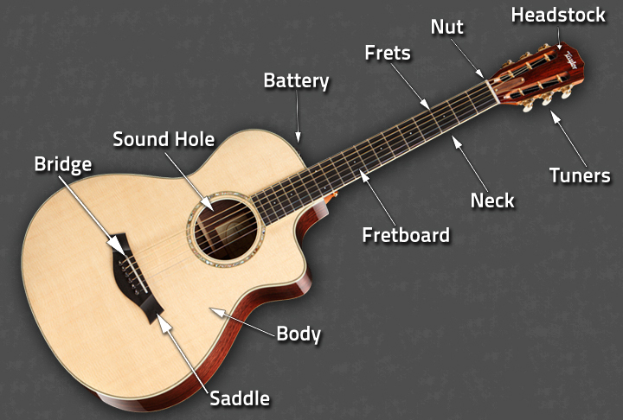
Guitar parts: acoustic

Slide 16
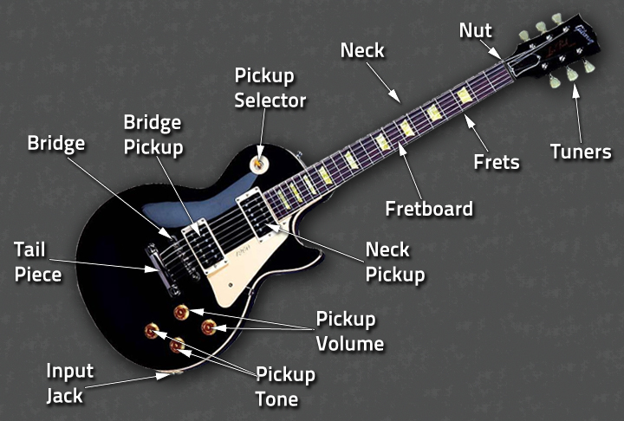
Guitar parts: electric

Slide 17
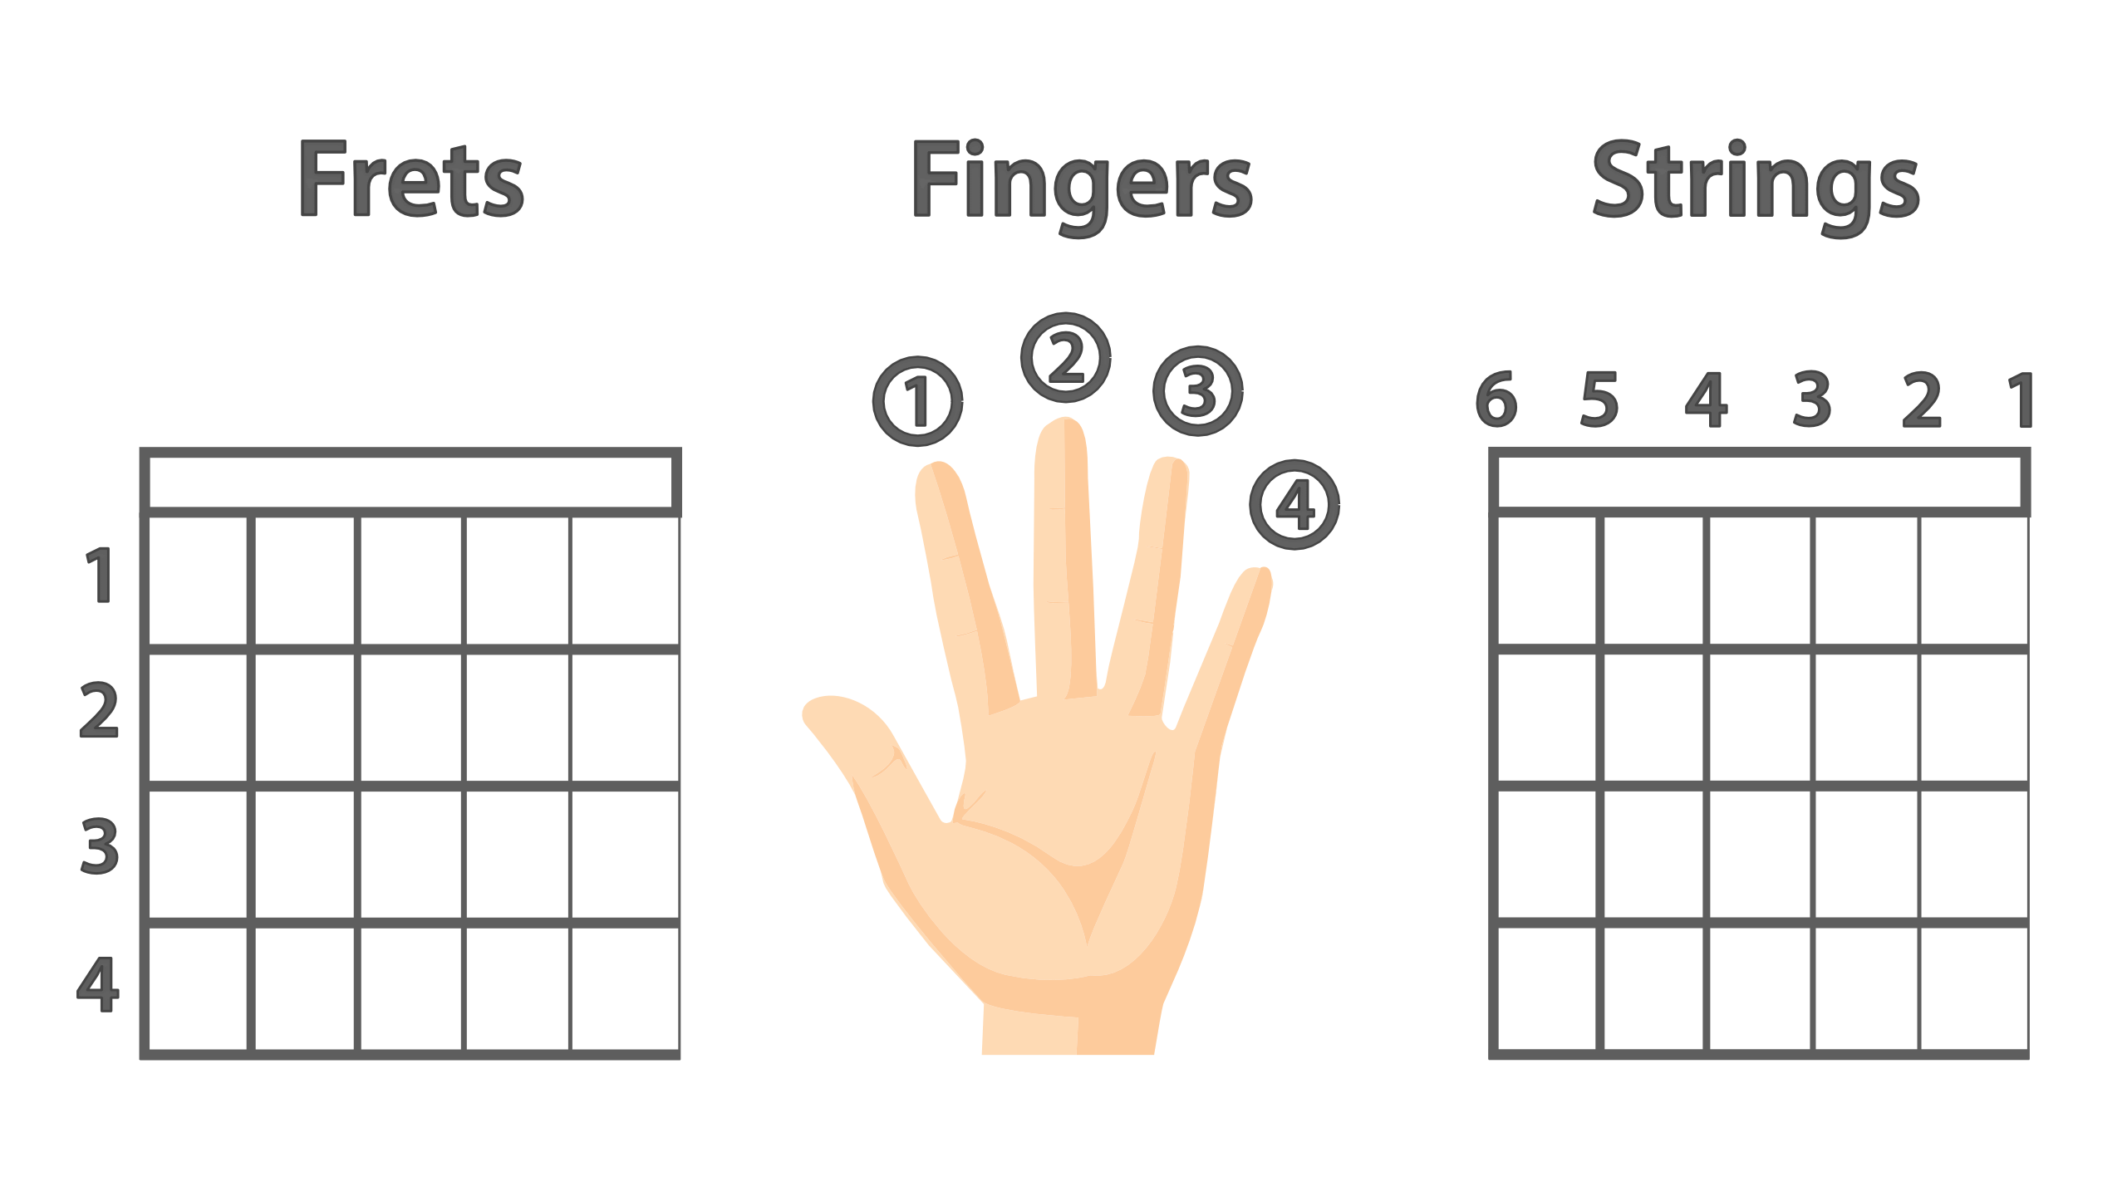
Fret, finger & string number notation

Slide 18
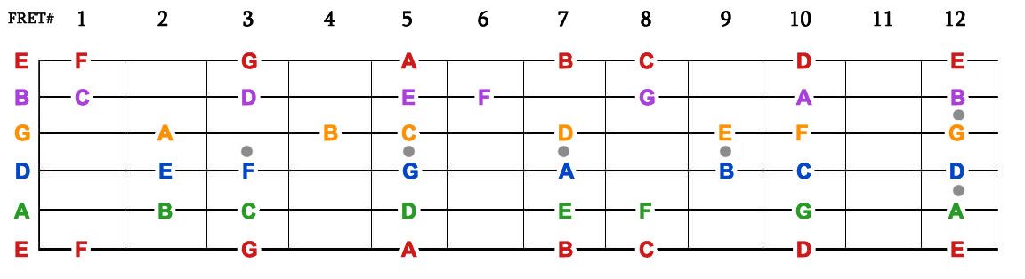
FRETBOARD NOTES
Exercise 1 : Identify the notes in the fret board
Exercise 2 : Play the diatonic scale

Slide 19
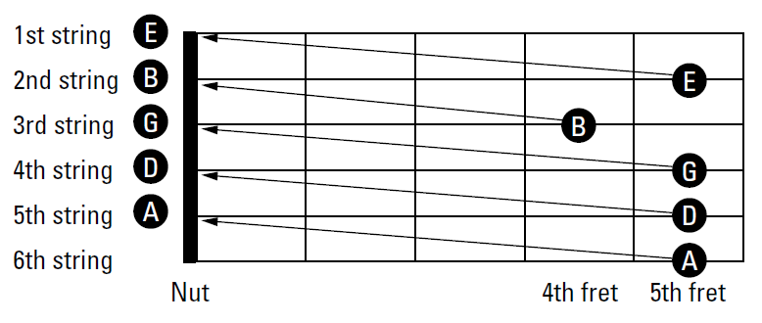
STANDARD tuning
E

Slide 20
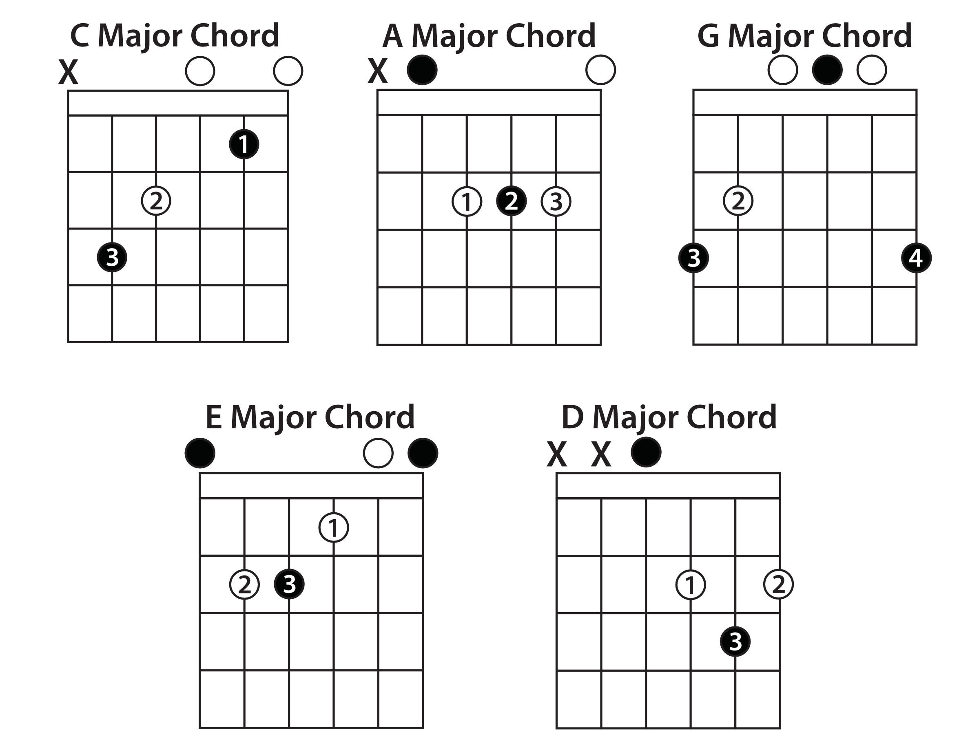
Your first chords : CAGED

Slide 21
Basic strumming
Most common time signatures
2/4
4/4
3/4
4/4 time signature– most basic beat in music
4 counts down strumming
Best accompanied with foot tapping
To get locked-in with the rhythm

Slide 22
Exercise
Play your first chords
Play your first song

